Slide 1
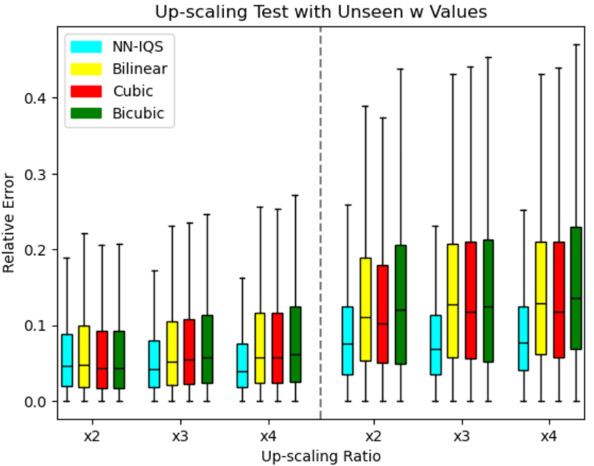
Whole Diagram
Transition Region

